Slide 1
Email Spam Detection
This presentation will explore the application of Naïve Bayes algorithm for email spam detection and discuss its advantages and limitations.
Group 6
Jayan S – 23033,
K S Jagan – 23034,
Keerthivasan S V– 23037,
Krish S – 23040

Slide 2
Introduction
Our project focuses on tackling this issue using a machine learning approach, specifically the Naive Bayes algorithm. The Naive Bayes algorithm is a popular choice for spam detection due to its efficiency and effectiveness.
It is based on applying Bayes' theorem with strong independence assumptions between the features. In this project, we aim to design and implement a spam detection system that can accurately classify emails as "spam" or "non-spam". We will train our model on a dataset of emails, extracting features such as the frequency of certain words or phrases typically found in spam messages.
The goal of the project is to design and implement a spam detection system that can accurately classify emails as “spam” or “non-spam”.

Slide 3
Identification
  Features of Spam Emails:
  Sender Names: Scammers often change email addresses to avoid being caught by the internet service provider (ISP), so if the sender's name is a random string, ex. “07sfs4Jdsfn5sdf”, then the email is likely spam
  Domain Names: If the email address is coming from a website that isn’t associated with the organization that the email is claiming to be from, the email is illegitimate
  Spelling/grammar: As rare as it is, spammers make spelling or grammatical errors in their emails
  Other features: Generic greetings, links to be clicked on, requiring urgent actions, etc.

Slide 4
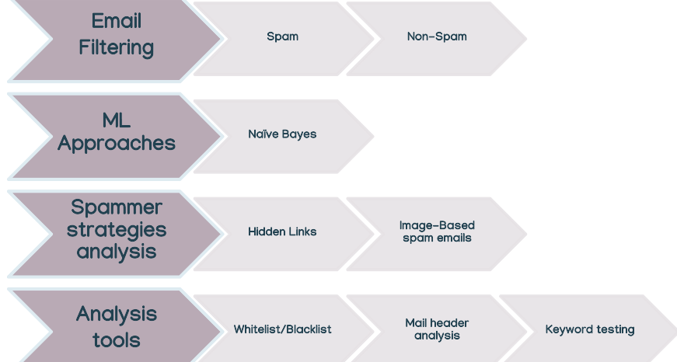
Processes

Slide 5
Naive Bayes Classification Algorithm
Naive Bayes is a probabilistic algorithm based on the Bayes theorem, which calculates the posterior probability of a given class label.
In email spam detection, the class label is spam or ham (not spam), and the attributes are words or tokens in the email content.
Given the class label, the naive assumption is that the attributes are independent of each other. The algorithm can be trained on a labeled email dataset, where the default probability of each category and the conditional probabilities of each item given each category are calculated from the data and then the algorithm can distribute an email in another by choosing the highest level next possible.

Slide 6
Naive Bayes Classification Algorithm ~ Working
The Naive Bayes classification algorithm works in the following way for email spam detection:
Tokenization: The algorithm starts by breaking down the email content into tokens, which are typically words.
Training: The algorithm is trained on a labeled email dataset. It calculates the default probability of each category (spam or ham) and the conditional probabilities of each token given each category.
Application of Bayes’ Theorem: The algorithm applies Bayes’ theorem to calculate the posterior probability that an email is spam or ham given the occurrence of specific tokens.
Classification: After calculating the probabilities, the algorithm classifies an email as spam or ham by choosing the category with the highest posterior probability.
Update: As new emails arrive and are classified by the user, the algorithm updates the probabilities, which improves its accuracy over time.

Slide 7
Naive Bayes Classification Algorithm ~ Advantages
The Naive Bayes classification algorithm has several advantages when it comes to email spam detection:
1. Efficiency: The Naive Bayes algorithm is computationally efficient, making it suitable for high-dimensional datasets, such as text data.
2. Simplicity: The algorithm is easy to understand and implement. It's based on the assumption of feature independence, which simplifies the computation.
3. Performance: Despite its simplicity, the Naive Bayes classifier often performs well and is particularly effective in solving multi-class problems.
4. Small Amount of Training Data: An advantage of the Naive Bayes classification is that it requires only a small amount of training data to estimate the parameters required for classification.
5. Stability: The Naive Bayesian algorithm has the advantages of high stability. The algorithm has a strong theoretical foundation based on Bayes' theorem.

Slide 8
Naive Bayes Classification Algorithm ~ Limitations
While the Naive Bayes classification algorithm is effective for email spam detection, it does have some limitations:
1. Assumption of Independence: The biggest limitation of the Naive Bayes classifier is its assumption of feature independence as it leads to inaccuracies. Words in an email are often not independent of each other.
2. Zero Frequency Problem: If the algorithm encounters a word in the test data set that was not present in the training data set, it will assign a zero probability to that word. This can affect the accuracy.
3. Subjectivity in Spam: What one person considers spam, another might not. This subjectivity can make it difficult for the algorithm to accurately classify all spam emails.
4. Concept Drift: The nature of spam can change over time (known as concept drift), which can affect the performance of the classifier.
5. Processing Overhead and Text Latency: The algorithm requires processing power and time to analyze and classify emails, which could lead to latency.

Slide 9
Methodology
Spam emails and messages are irrelevant or inappropriate email messages sent in bulk to many recipients for fraudulent purposes. Our project aims to identify these messages and inform the user so that they may take the necessary action.
The first task is to preprocess the data before it can be used. This includes obtaining the data from the file, and then organizing it into a usable manner. The data is in the form of a list, with the label and message as a pair.
Next, we extract the features and common words present in spam and ham (non-spam) messages in our dataset and determine the frequency of their usage in each category and establish a label for them. We then use this data to train our Naïve Bayes Classifier algorithm.
Lastly, we enter a message, and perform similar operations, such as preprocessing and feature extraction. We compare the features of the given message to the known features of a spam and ham message, and classify it based on the similarity and dissimilarity to each.

Slide 10
Implementation
We have created this program in the Python programming language. The reason for our choice is due to our prior knowledge of the language, as well as the greatly available libraries which can be used for many purposes and have vast capabilities.
We use the CSV library to handle and manipulate the file containing our dataset
We use Natural Language Toolkit (NLTK) for:
List of stop words, which are words that have no relation to the content
Tokenizer, to separate the text into words
Frequency distributor to sort the frequency of word usage for feature extraction
Naïve Bayes Classifier as our algorithm

Slide 11
Dataset and Evaluation Metrics
We used a dataset that was used by many others, on Kaggle notebooks as well as GitHub repositories
In the form of a Comma Separated Value (CSV) file
5500+ rows, 2 columns, with the first row containing the field headers, “message” and “label”
For our evaluation metrics, we used the frequency of word occurrences
Since the Naïve Bayes Classifier is based on probability, which requires frequency
It is easier to calculate and efficient
Also attempted using the TF-IDF Vectorizer, which uses the weights of words
However, since it has overlap with Naïve Bayes Classifier, the results were inaccurate compared to using only Naïve Bayes

Slide 12
Results
We entered various styles of messages, both spam and ham (non-spam)
Our program was able to accurately classify the message as spam or ham
User runs the preload file to perform the operations and train classifier on training dataset
User then runs the detection file
Upon running the detection file, a window is generated, containing a field to enter the message, and a button to submit it
When the user enters a message and clicks on the button to submit it, a classification is returned
The window stays open until the user decides to close it manually
This was done so that many messages could be inputted by the user, without having to run the program multiple times

Slide 13
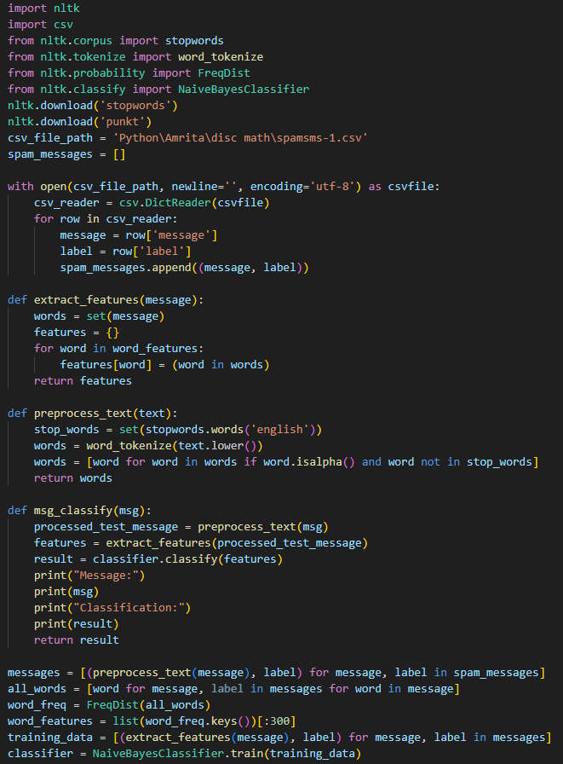
Code ~ Preload file

Slide 14
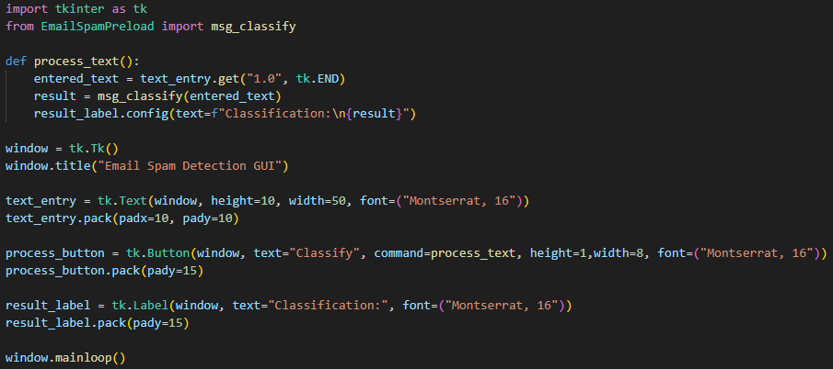
Code ~ Run/Detection file

Slide 15
Literature Review
Kaggle: Spam/Ham detection using Naive Bayes Classifier: This Kaggle notebook demonstrates the application of the Naive Bayes Classifier for spam/ham detection. The classifier is trained on a dataset containing various subjects of emails classified as either Spam or Ham.
GitHub: nikhilkr29/Email-Spam-Classifier-using-Naive-Bayes: This GitHub repository contains a Naive Bayes spam/ham classifier based on Bayes’ Theorem. The classifier is trained on a set of email subjects and then used to predict whether a previously unseen email subject is Spam or Ham.
GitHub: stuntgoat/Generic-Naive-Bayesian-Classifier: This GitHub repository contains code for a generic Naive Bayes classifier.
GitHub: vishal-verma27/How-To-Build-Email-Spam-Classification-Model-With-99-Accuracy: This GitHub repository provides a guide on how to build an email spam classification model with 99% accuracy using the Naive Bayes algorithm.
GeeksforGeeks: Naive Bayes Classifiers: This article explores Naive Bayes classifiers, a family of algorithms based on Bayes’ Theorem. Despite the “naive” assumption of feature independence, these classifiers are widely utilized for their simplicity and efficiency in machine learning.
Analytics Vidhya: Naive Bayes Explained: This article provides a comprehensive explanation of the Naive Bayes algorithm, its applications, pros, and cons, and how to implement the Naive Bayes Classifier in R and Python.
IBM: What are Naive Bayes classifiers?: This IBM article explains what Naive Bayes classifiers are, how they work, and why they are considered “naive.” It also discusses the assumptions made by these classifiers.
Scikit-learn: Naive Bayes: This documentation from Scikit-learn provides information about the Naive Bayes classifier for multivariate Bernoulli models.
Stack Overflow: A simple explanation of Naive Bayes Classification: This Stack Overflow thread provides a simple and easy-to-understand explanation of the Naive Bayes classification algorithm.

